Slide 1
Notes:
徐家汇辐射范围（康帕斯法则）http://wiki.mbalib.com/wiki/%E5%BA%B7%E5%B8%95%E6%96%AF%E6%B3%95%E5%88%99

Slide 2
Notes:
徐家汇

Slide 3
Notes:
中山公园

Slide 6
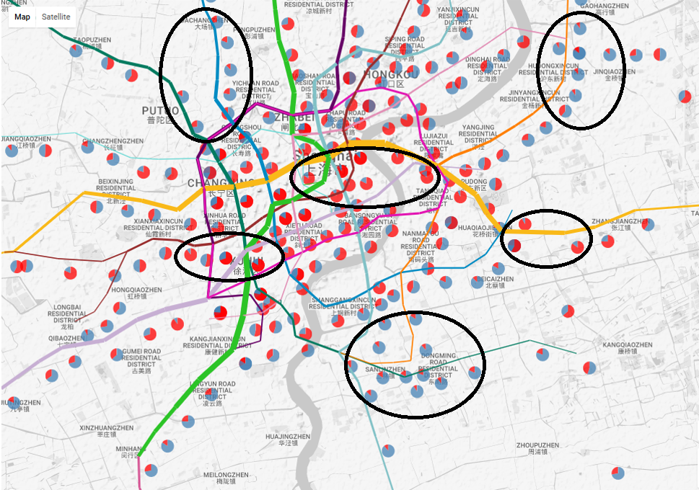
work area
residential area
residential area

Slide 8
Xujiahui
East Nanjing Road
Zhongshan Park
Longyang Road
Actual
Huff
Huff(subjective)
Huff(objective)
Ours

Slide 9
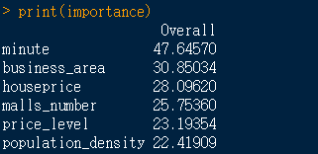

Slide 10
Xujiahui
East Nanjing Road
Zhongshan Park
Longyang Road
Trade Area
Customer

Slide 11
Xujiahui
East Nanjing Road
Zhongshan Park
Longyang Road
Actual
Ours
（Transfer times）
Ours

